Slide 1


Sky Line
REAL ESTATE

Slide 2




Howard Ong
Aaron Loeb
Our Team
Drew Feig
Avery Davis
Drew Feig

Slide 3
Introduction
Tools Used
Database System
Table of Content
Structure Query Language
Data Warehousing
SSIS & SSRS
Power BI Dashboard

Slide 4
Introduction
This project focuses on analyzing real estate data to uncover key business insights and support strategic decision-making. It involves studying various aspects such as property sales, client interactions, broker performance, and commission structures. By transforming raw data into clear and meaningful insights, the project aims to help real estate stakeholders improve operations, identify opportunities, and understand market trends more effectively.

Slide 5






Tools Used
Integrate Data (SSIS)
Create Reports (SSRS)
Design and Build Enter Active Dashboards
Design and Build Database & Data Warehouse
Design Entity Relationship Diagram & Mapping
Data Generator
For Documentation
Meeting Team
Agile Methodology

Slide 6
Database System
01. Entity Relationship Diagram
02. Mapping
03. Creation
04. Tables

Slide 7
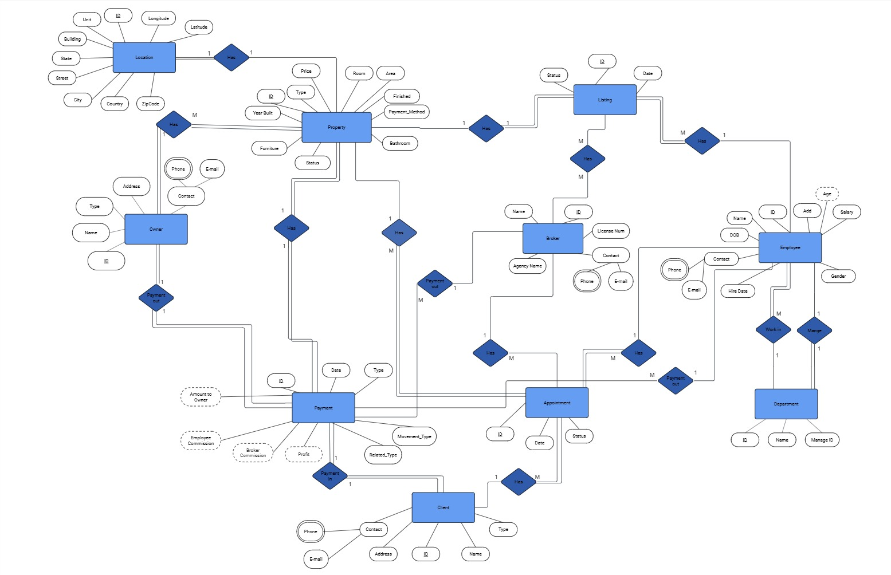
01. Entity Relationship Diagram

Slide 8
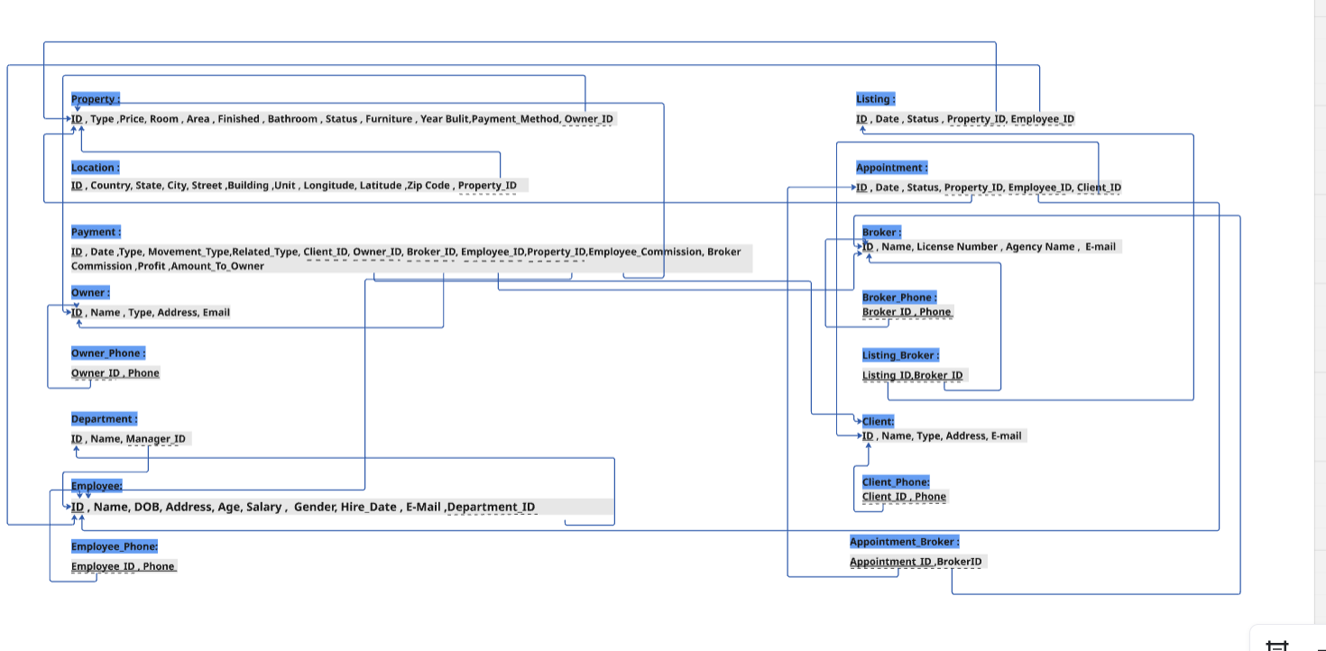
02. Mapping

Slide 9
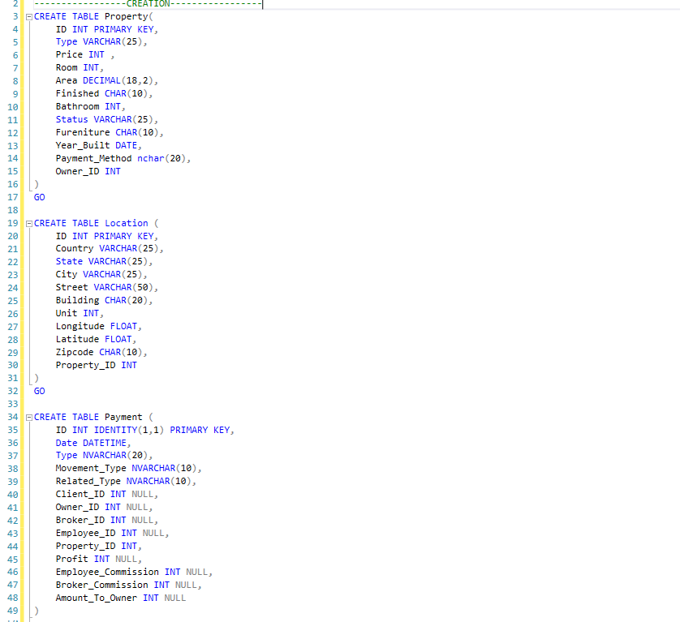
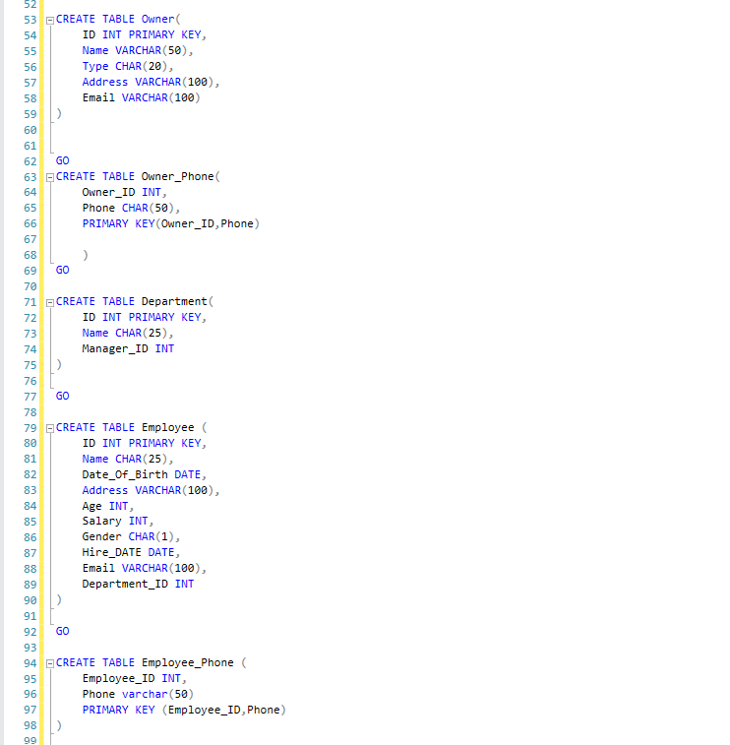
03. Creation

Slide 10
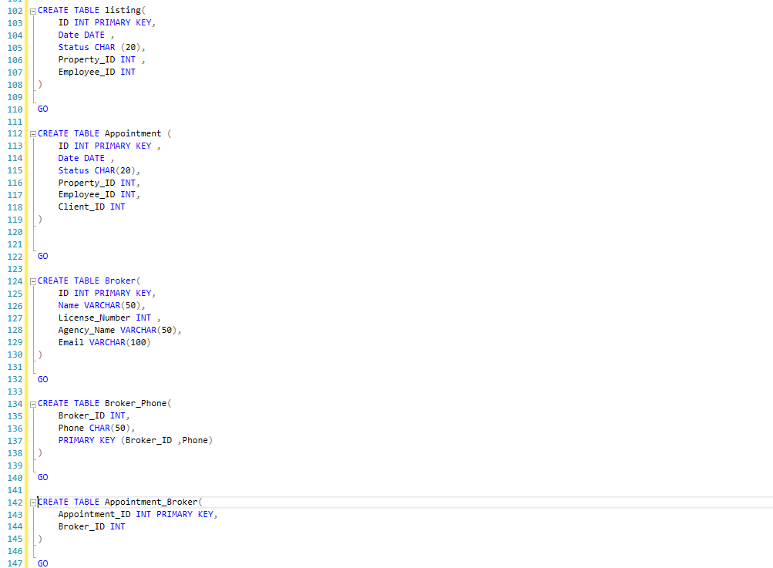
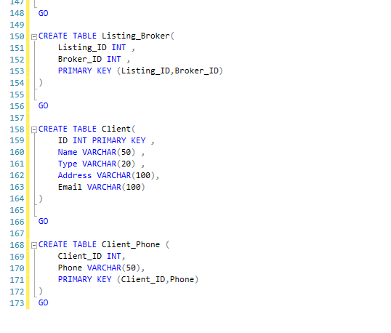
03. Creation

Slide 11
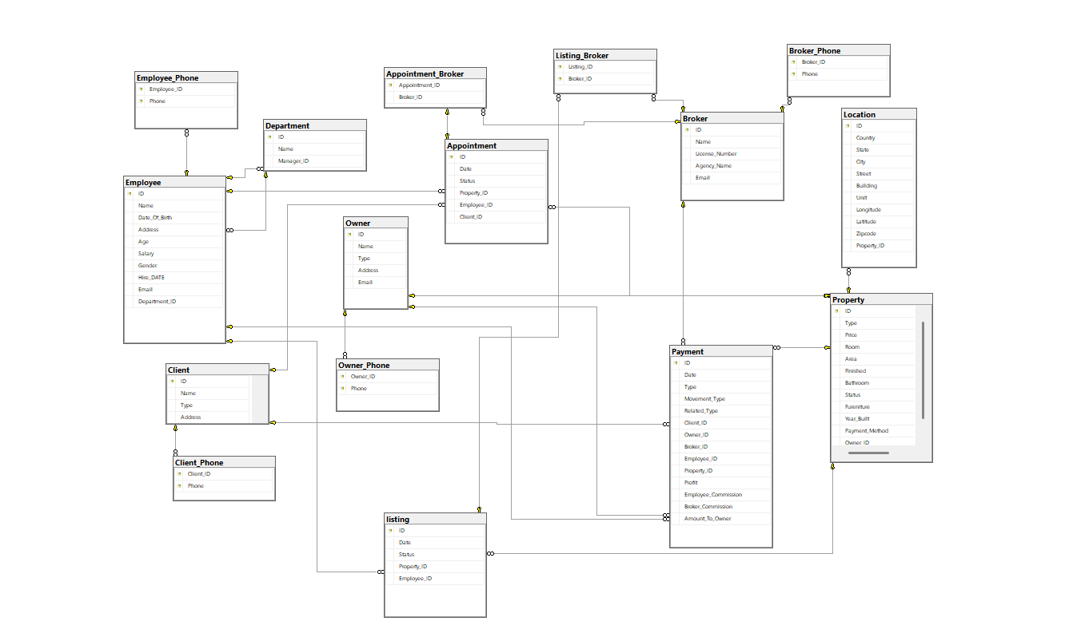
04. Tables

Slide 12
Structure Query Language
01. Views
02. Stored Procedures
03. Triggers

Slide 13
01. Views
View Name | Definition
Active_Listings | Published Listings with Property Details
Appointment_Details | Appointment Details with Client and Property
Appointment_Monthly | Appointments Per Month
Broker_Appointment_Listing | Find Appointment and Listing per Broker
Broker_Commission | Appear every Broker has Total Commission Earned
Broker_Performance | Find Number of deals and Total Revenue per Broker
Client_Overview | Appear Information about Client
Client_Payment | Appear Client name and number of payment and total pay
Employee_Appointment_Listing | Find Number of Appointment and number of Listing by Employee
Employee_Commission | Appear every Employee has Total Commission Earned

Slide 14
01. Views
View Name | Definition
Listing_Broker_Details | Find every listing and Broker Name make this list
Listing_Status | Count every listing by Status
Monthly_Payment_Report | Count number of Payment and Total Payment Every Month in Every year
Owner_Earnings | Appear Every Owner Name and Total Earned by buy Property
Owner_Properties | Find Every Owner and your Property Properties
Payment_Transactions | Appear Every Payment about Profit, Commissions, Amount to Owner
Property_By_Type | Find Every type of Property and Average Price
Property_Full_Details | Appear Everything about Property

Slide 15
02. Stored Procedures
Stored Procedures Name | Definition
AddEmployee | Add new Employee and add to department
UpdateEmployee | Update any Employee
DeleteEmployee | Delete Employee from System
GetEmployeeByID | Find any Employee by ID
AddProperty | Add new Property and Properties
UpdateProperty | Update Property and Properties
DeleteProperty | Delete any Property from Table after pay
GetPropertyByID | Find any Property details by ID
AddClient | Add new Client to system
UpdateClient | Update Client Information

Slide 16
02. Stored Procedures
Stored Procedures Name | Definition
AddOwner | Add new Owner want to pay our Property
AddBroker | Add new Broker to system
ScheduleAppointment | Add new Appointment information by Date, Status, Property, Employee, Client
UpdateAppointmentStatus | Transform Appointment Status from Ongoing to Done or to Cancelled
CreateListing | Create new list by Employee is must or but by Broke is may ber
RecordPayment | Record any Payment Transaction is Done From client or to Employee, Broker, Owner, Profit
GetBrokerCommissions | Perform Commission of Broker if in the sale in Property
GetEmployeeAppointmentsByDate | Find any Appointment is done by employee-by-Employee ID and Date of Appointment

Slide 17
02. Stored Procedures
Stored Procedures Name | Definition
SearchProperties | Search from Property by Max or Min Price, Room, Bathroom, City, Status
AssignBrokerToAppointment | If Appointment is done by specific Broker this prevent duplicate same Appointment by same Broker
UpdatePropertyOwner | Update Property by New Owner
GetPaymentsSummary | Appear Anything about Payment by some of Properties (Date, Employee ID, Client ID, Payment Type)

Slide 18
03. Triggers
Triggers Name | Definition
trg_Employee_Salary_Update | If an employee's salary is updated, the new salary is recorded
trg_Prevent_Client_Delete | This prevents you from deleting a client if they still have a scheduled appointment
trg_Broker_Negative_Commission | This prevents the commission from being negative for the broker
trg_Broker_Negative_Commission | This prevents the commission from being negative for the employee
trg_Update_Listing_Status | If 30 days have passed since the listing, it will be marked as expired
trg_Block_Property_Without_Owner | Prevents adding any property that doesn't have an Owner_ID
trg_Appointment_Default_Status | If an appointment is added without a status, the default will be set to Pending

Slide 19
03. Triggers
Triggers Name | Definition
trg_Log_Broker_Delete | If a broker is deleted, they are saved in another table along with the deletion date
trg_Update_Property_Status_On_Payment | If a payment is made, the status of the related property is changed to Sold
trg_Count_Owner_Properties | When a property is added or deleted, another table is updated to reflect each owner and their associated properties
trg_No_Friday_Appointment | Prevents booking an appointment on Fridays
trg_Limit_Employee_Listings | Prevents entering more than 10 listings for the same employee on the same day
trg_Backup_Property_Before_Update | Creates a backup copy of the old property data in the Property_Backup table
trg_Prevent_Delete_Owner_With_Properties | You cannot delete an owner who still has properties

Slide 20
03. Triggers
Triggers Name | Definition
trg_No_Duplicate_Appointments_For_Client | Prevents appointment conflicts for the same client
trg_Property_Type_Required | Validates the existence of the type before insertion
trg_Prevent_Major_Price_Cut | Ensures there is no manipulation or significant underpricing
Set_Commercial | Set_Commercial for room, bathroom, price, Area
Set_Apartment | Set_Apartment for room, bathroom, price, Area
Set_Single_Family | Set_Single_Family for room, bathroom, price, Area
Set_Multi_Family | Set_Multi_Family for room, bathroom, price, Area
Set_Townhouse | Set_Townhouse for room, bathroom, price, Area
Set_Condo | Set_Condo for room, bathroom, price, Area
Insert_Payment | Calculate Profit, Employee Commission, Broker Commission, Amount to Owner

Slide 21
Data Warehousing
we began the data warehouse transformation process, focusing on converting traditional databases and tables into a structured format consisting of fact and dimension tables. This restructuring enhances business insight and enables efficient data analysis. We utilized tools such as SSIS to manage the ETL process, transforming and categorizing tables appropriately as Fact or Dimension and defining their relationships. Additionally, we used SSAS to extract analytical structures that support advanced reporting, which we implemented using SSRS

Slide 22



01. SSIS
Data Warehousing
02. Tables
03. SSRS

Slide 23
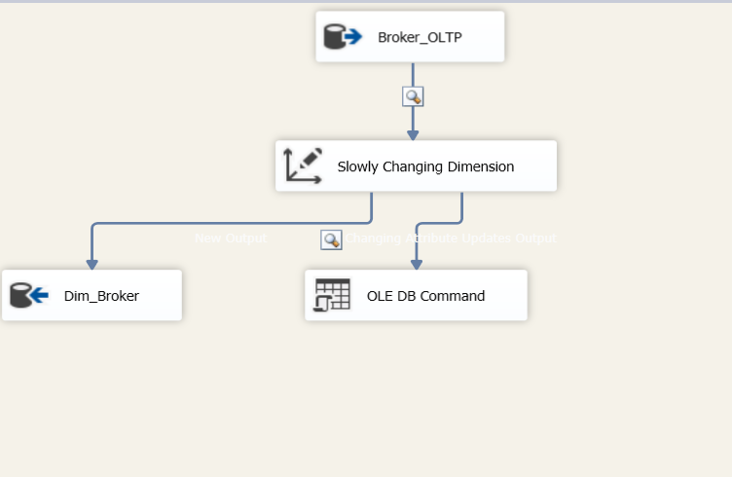
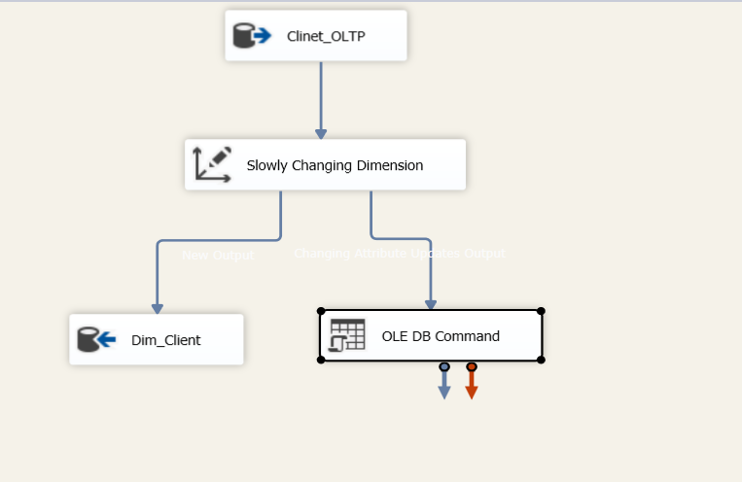
01. SSIS (DIM Tables)

Slide 24
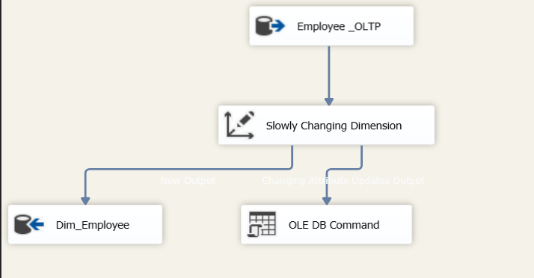
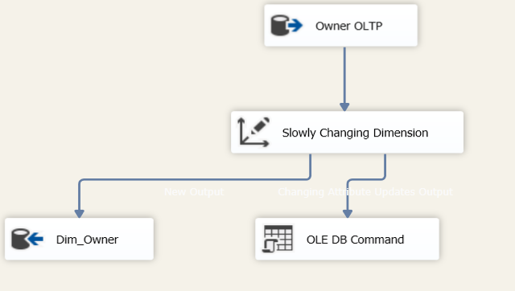
01. SSIS (DIM Tables)

Slide 25
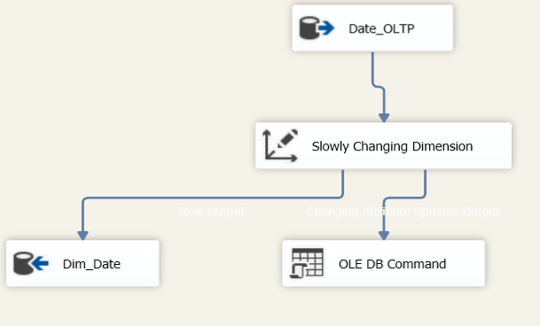
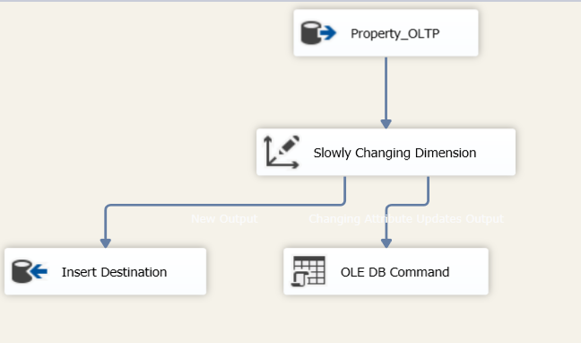
01. SSIS (DIM Tables)

Slide 26
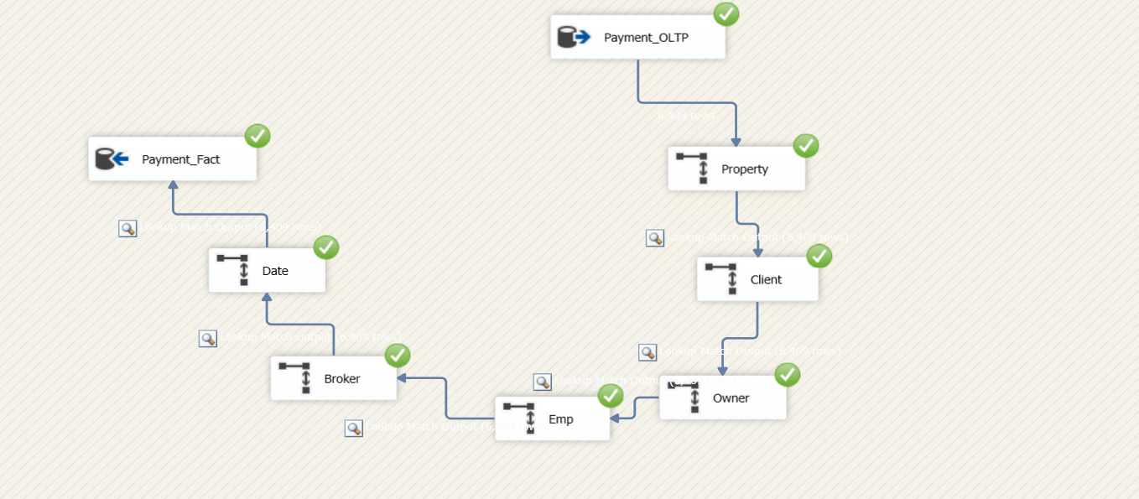
01. SSIS (Fact Tables)

Slide 27
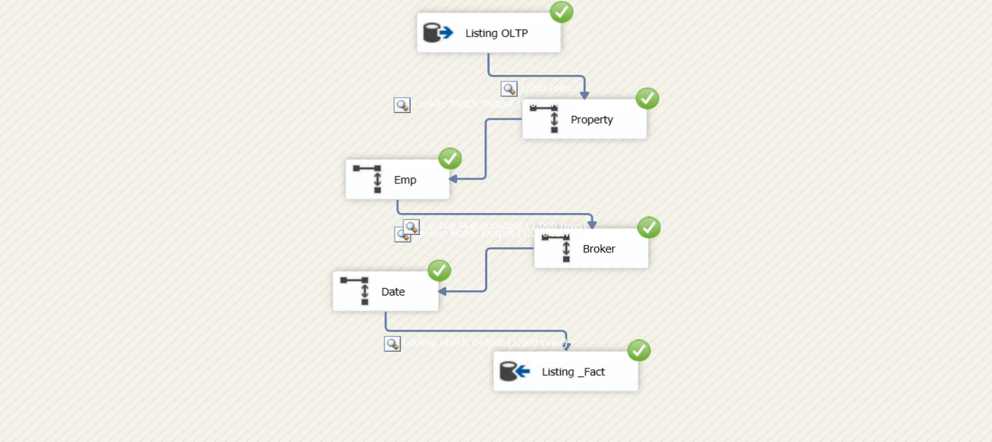
01. SSIS (Fact Tables)

Slide 28
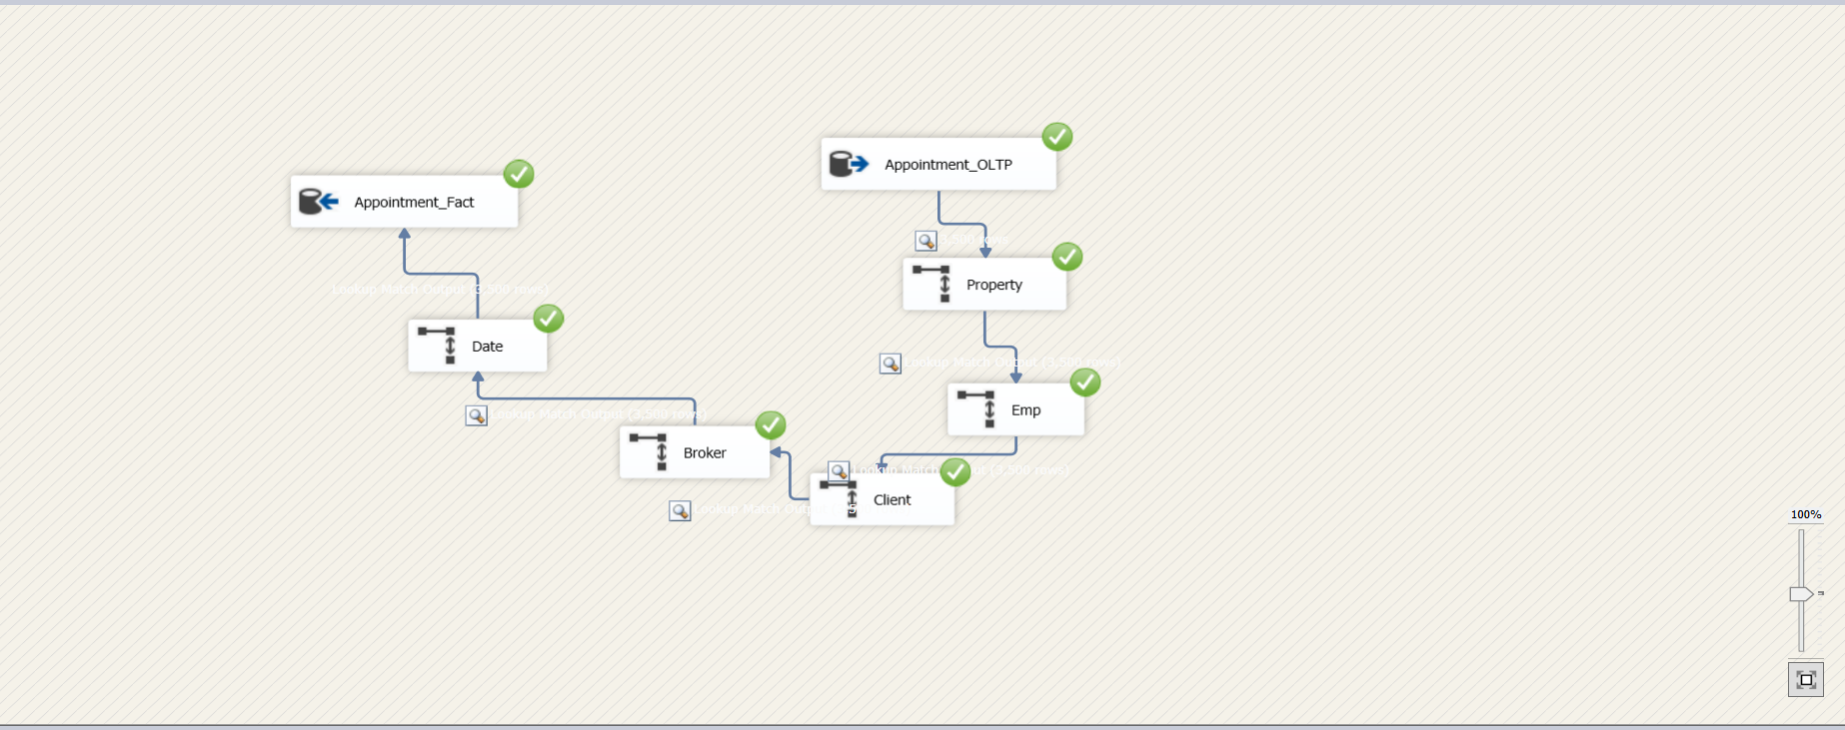
01. SSIS (Fact Tables)

Slide 29
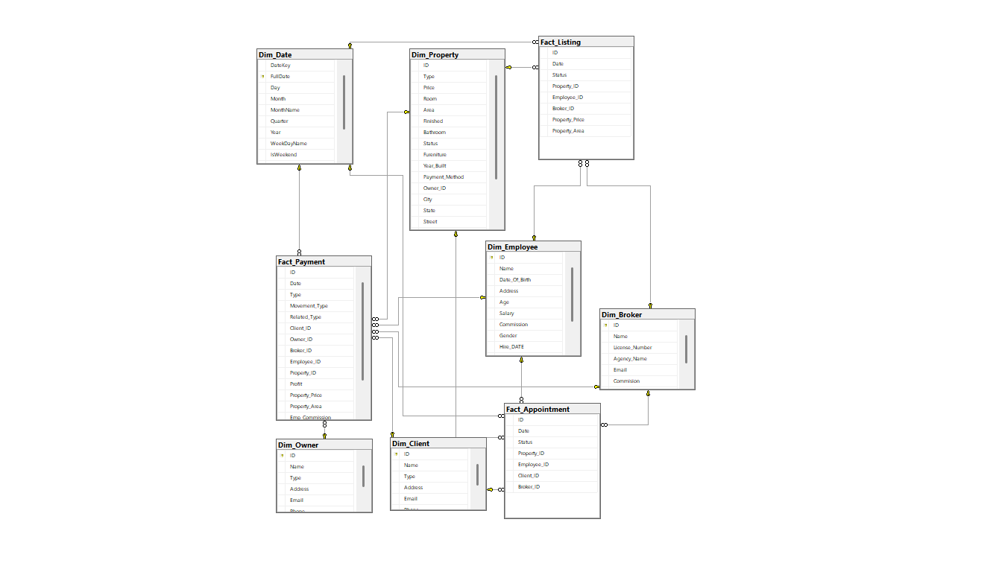
02. Tables

Slide 30
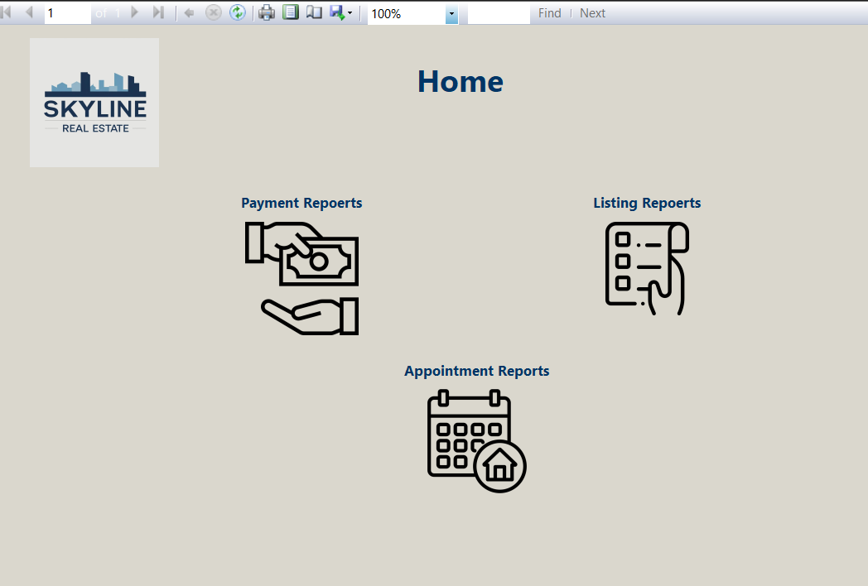
03. SSRS

Slide 31
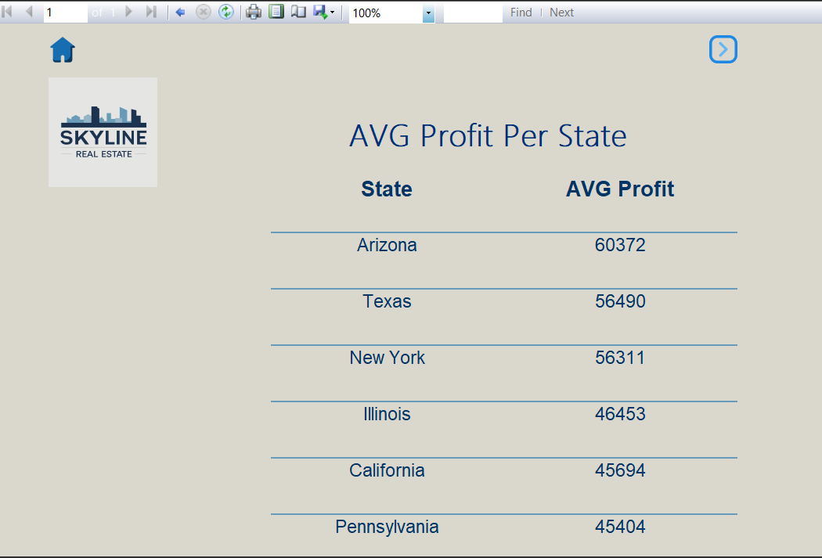
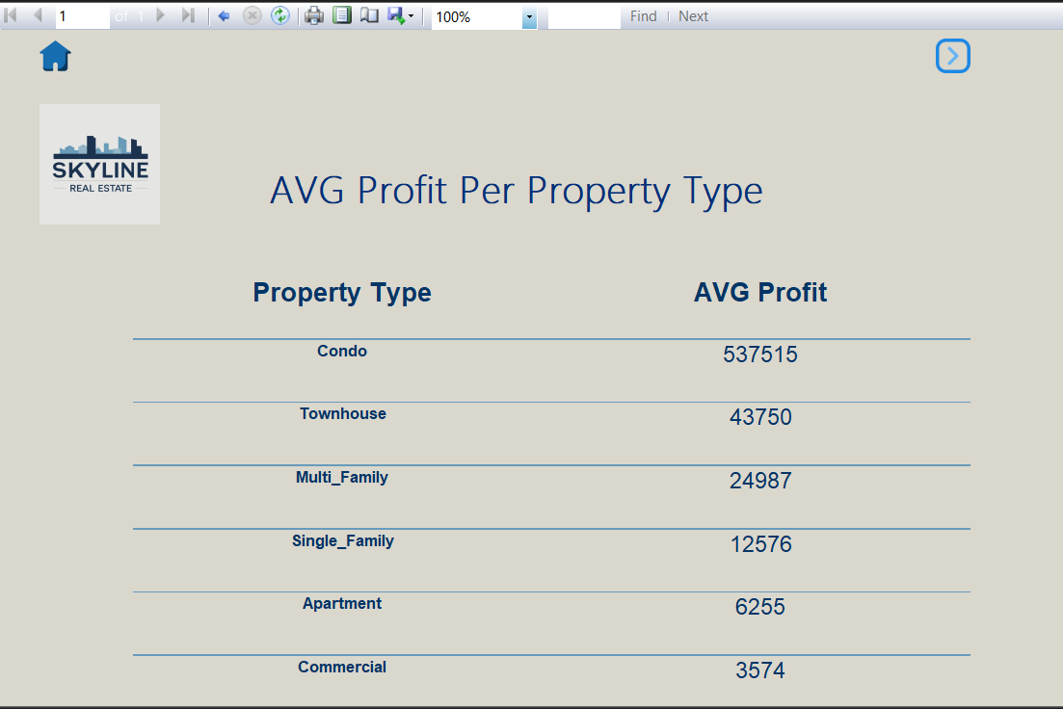
03. SSRS

Slide 32
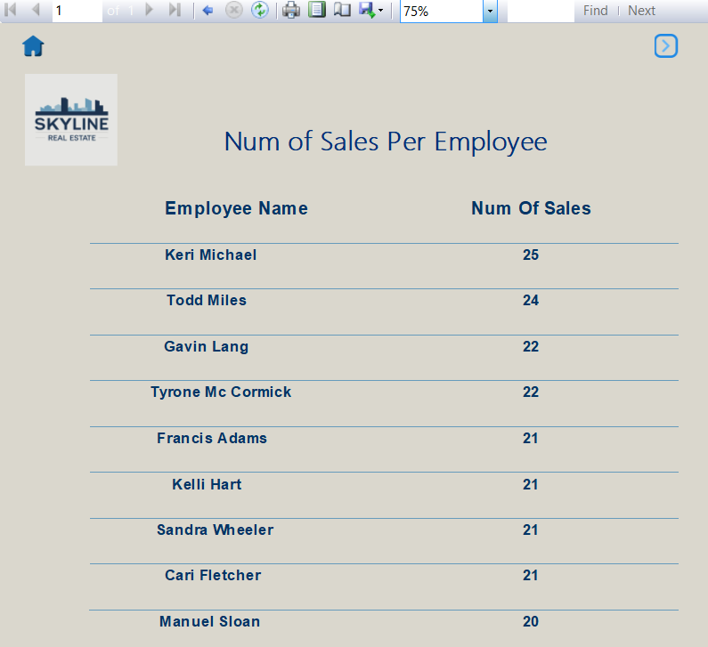
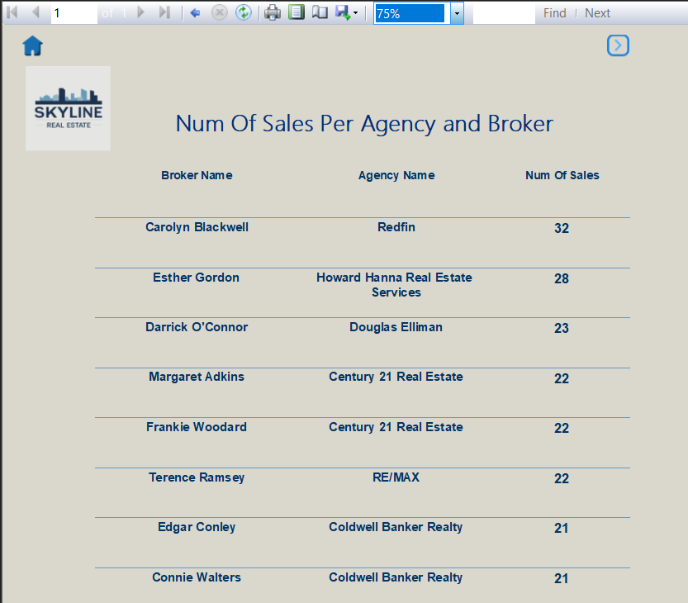
03. SSRS

Slide 33
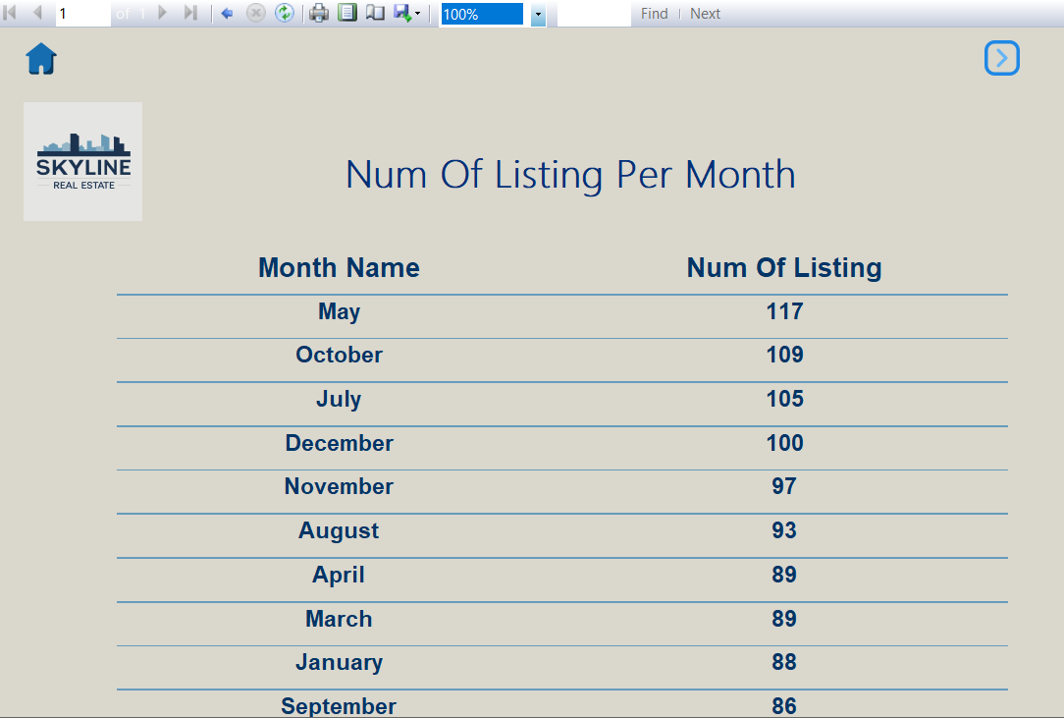
03. SSRS

Slide 34
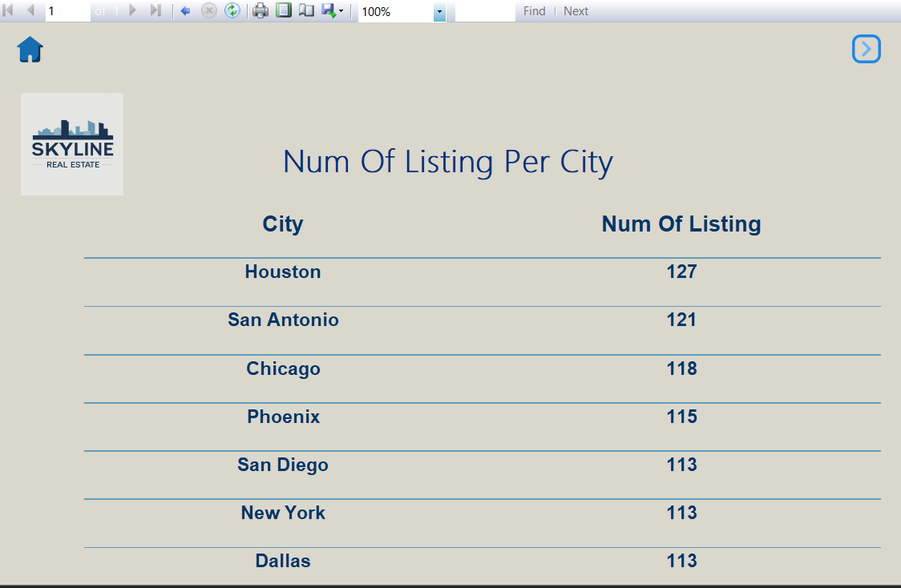
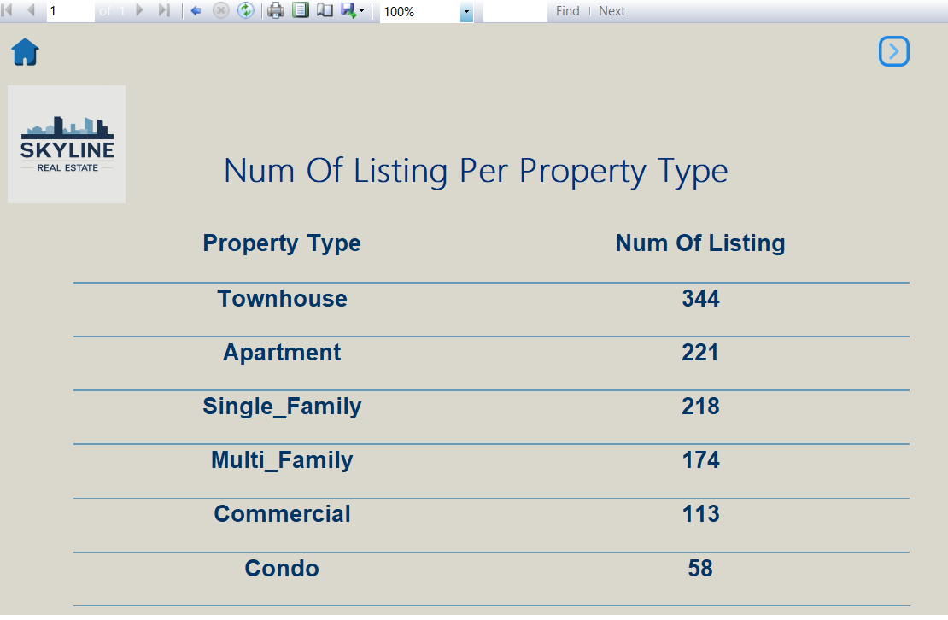
03. SSRS

Slide 35
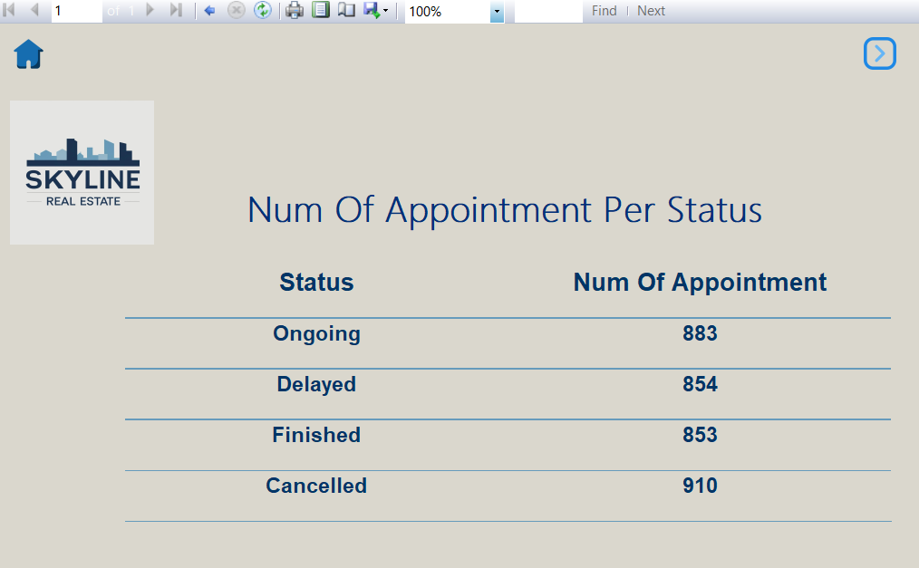
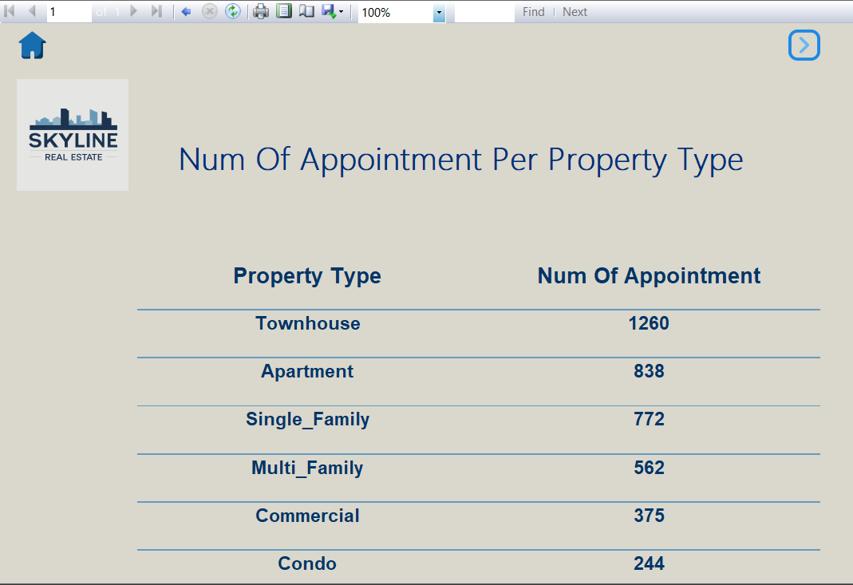
03. SSRS

Slide 36
Power BI Dashboard
As part of the Real Estate Data Warehouse project, Power BI was utilized to transform raw data into interactive and insightful dashboards. The goal was to enable stakeholders to monitor and analyze key performance metrics related to properties, clients, listings, brokers, and financial transactions.
Advanced DAX measures, slicers, and drill-down capabilities were applied to ensure interactive and user-friendly reports. Each dashboard provides a real-time analytical view to support better decision-making in the real estate business context

Slide 37
Our Dashboard
1
2
3
4
5
Home
Payment
Appointment
Listing
Property
6
7
8
9
Broker
Owner
Client
Employee

Slide 38

1
Home

Slide 39
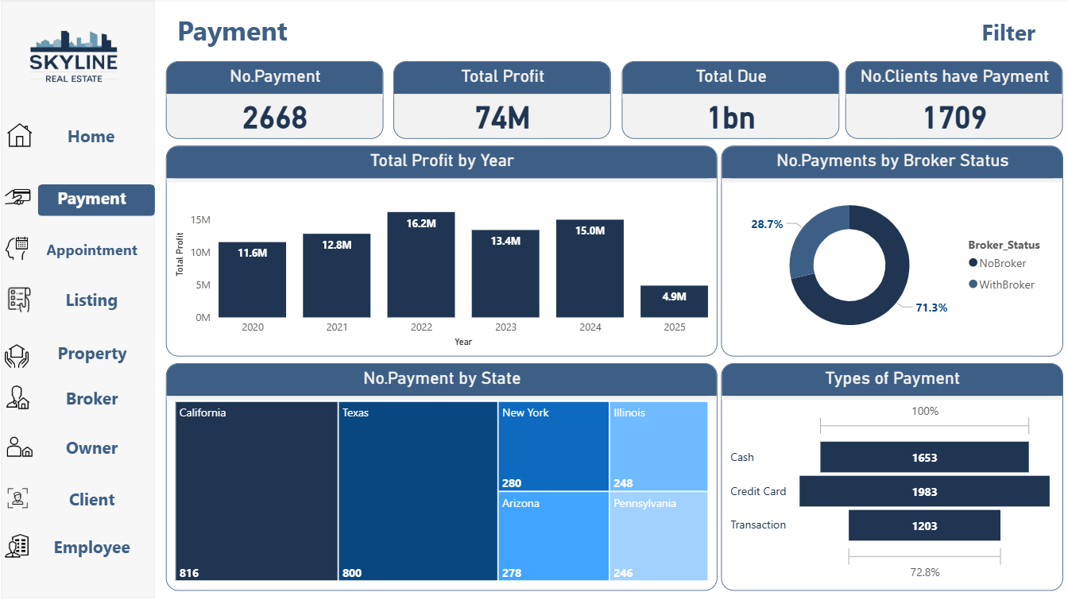
2
Payment

Slide 40
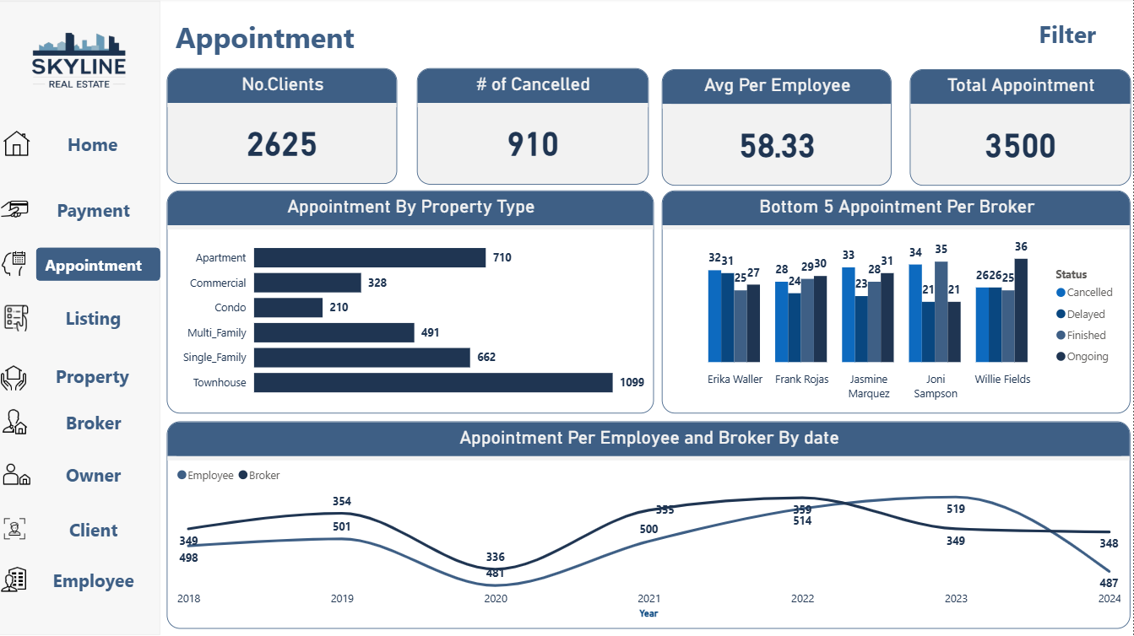
3
Appointment

Slide 41
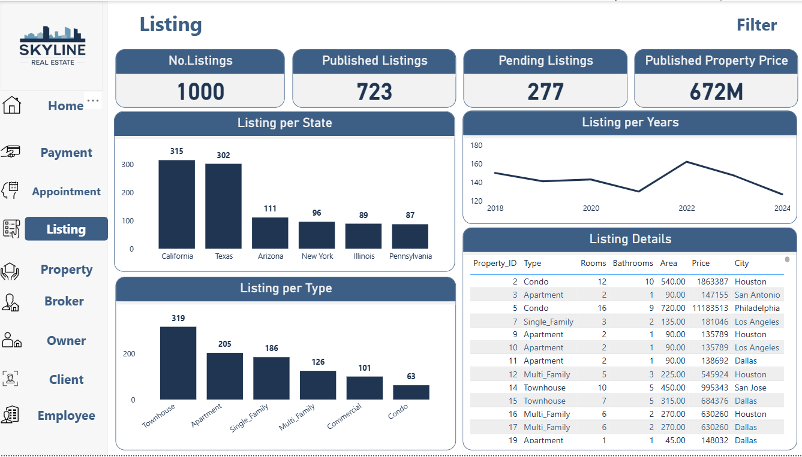
4
Listing

Slide 42
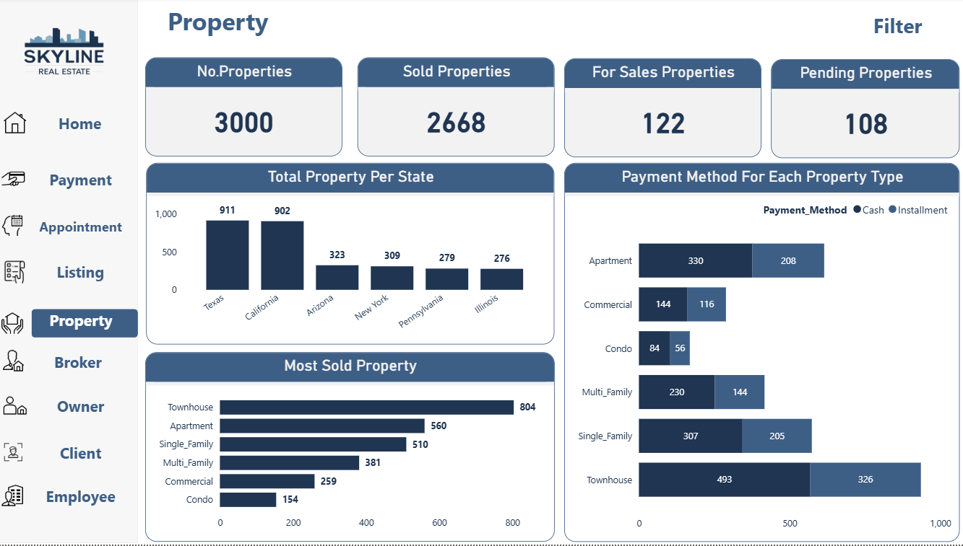
5
Property

Slide 43
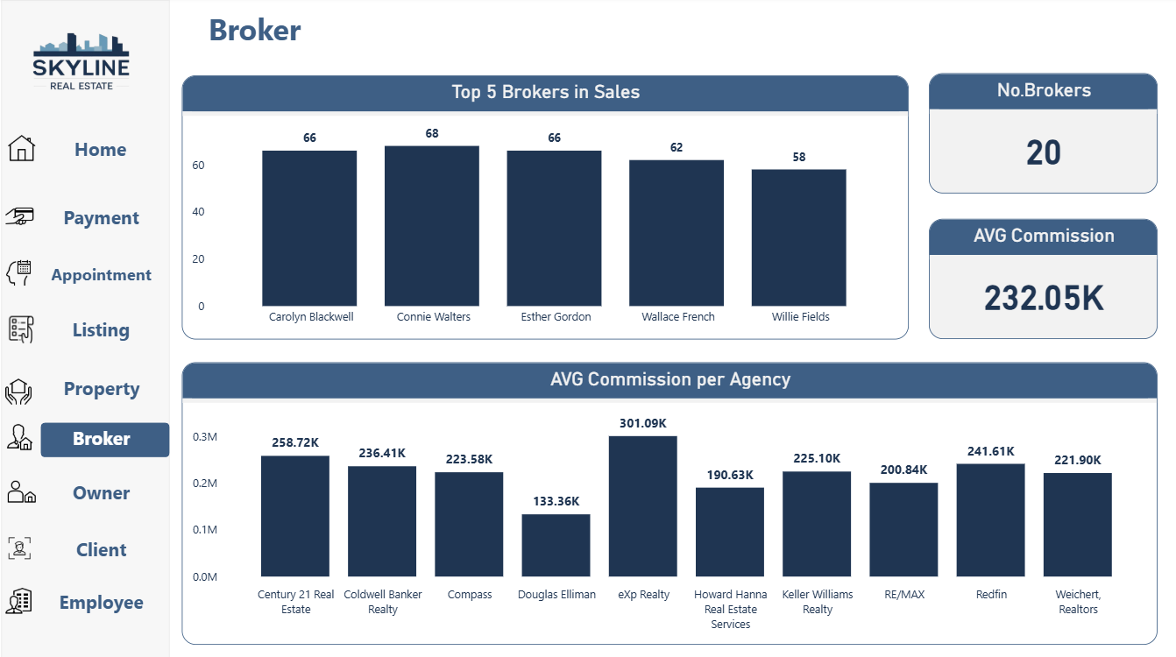
6
Broker

Slide 44
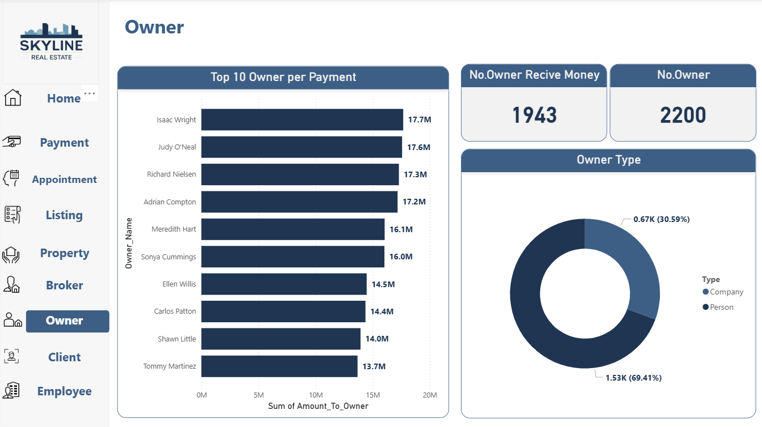
7
Owner

Slide 45
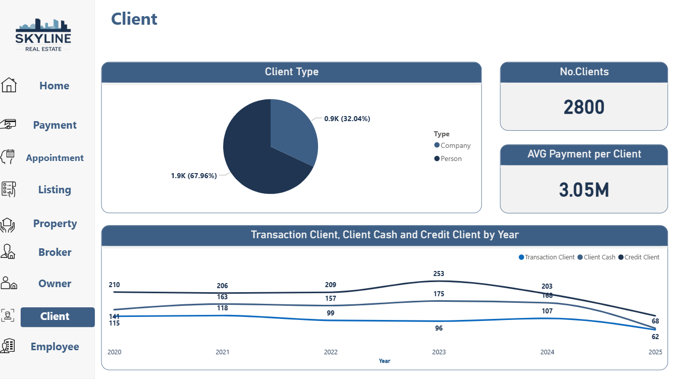
8
Client

Slide 46
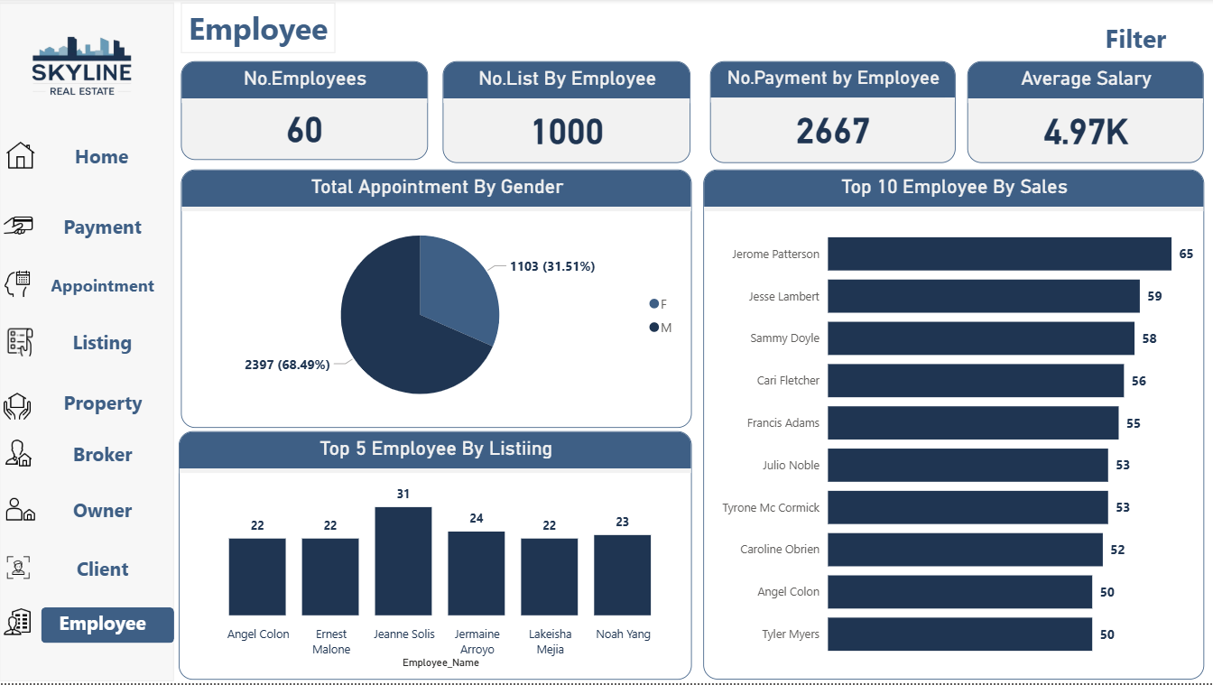
9
Employee

Slide 47
Our Services
Presentations are communication tools that can be used as demonstrations, lectures, speeches, reports, and more. It is mostly presented before an audience.
Services 01
Services 02
Services 03
It is mostly presented before an audience.
It is mostly presented before an audience.
It is mostly presented before an audience.

Slide 48
Thank You

Slide 49

Vision
Presentations are communication tools that can be used as demonstrations, lectures, speeches, reports, and more. It is mostly presented before an audience.

